Slide 1







AWS
Amazon CloudFront
Global Content Delivery Network (CDN) Service
Accelerating content delivery worldwide

Slide 2














Introduction to CloudFront
AWS
Amazon CloudFront is a fast, highly secure, and programmable Content Delivery Network (CDN) service that accelerates the distribution of content to users globally.
Fast
Secure
Programmable
Delivers content with minimal latency by routing users to the nearest edge location worldwide.
Protects content with integrated DDoS protection, Web Application Firewall, and HTTPS support.
Customizes content delivery with edge computing capabilities and API integration.
Content Types Supported:
HTML/CSS/JavaScript
Images
Video Streams
APIs

Slide 3







Core Concepts and Architecture
AWS
CloudFront's architecture consists of interconnected components that work together to optimize content delivery at global scale.
Edge Locations (POPs)
Regional Edge Caches
Global network of data centers that cache content and serve user requests with lowest latency.
Larger intermediate caches positioned between origin servers and edge locations.
Located in over 47 countries
Improve cache hit ratios for less popular content
Provide cache hit for frequently requested content
Reduce origin server load
Origins
Distributions
The definitive source of content for CloudFront to distribute.
Configurable units that define how content is delivered to users.
Amazon S3 buckets
Origin servers
Amazon EC2 instances
Access and security rules
Media Services
Caching behaviors
Custom HTTP servers
Domain names and SSL certificates

Slide 4











Global Network Infrastructure
AWS
CloudFront leverages a vast global network infrastructure to ensure content is delivered with minimal latency.
Edge Locations
Cities
Countries
600+
90+
Strategically located worldwide
47
Covered by CloudFront network
Points of Presence worldwide
Key Benefits of Global Infrastructure:
Reduced latency
Global reach
Optimized routing

Slide 5














Content Delivery Process
AWS
CloudFront delivers content through a global network of edge locations, optimizing performance and reducing latency.
1
2
3
User Request
DNS Routing
Edge Cache Check
User accesses a website or application, sending a request for an object.
DNS routes the request to the nearest edge location based on latency.
CloudFront checks its cache at the edge location for the requested object.
4
5
6
Regional Edge Cache
Origin Request
Content Delivery
If not in edge cache, request is forwarded to the nearest Regional Edge Cache.
If still not found, request is forwarded to the origin server.
Origin server sends the object back, which is delivered to the user and cached.
Key Points:
Edge locations cache content for low latency delivery
Regional Edge Caches improve cache hit ratios

Slide 6

















Key Features: Content Caching
AWS
Time to Live (TTL)
Cache Behaviors
Content Types
Controls how long content remains in edge caches before checking origin for updates.
Provide granular control over how different URL path patterns are handled.
Support for various content types optimizes delivery performance.
Origin selection for specific paths
Static Files
Streaming Media
Default TTL: 24 hours
Minimum TTL: 0 seconds
Query string and cookie forwarding
Fine-grained control over content freshness
Allowed HTTP methods configuration
Dynamic Content
APIs
Path Patterns:
TTL Configuration Example:
/images/*
Supported File Extensions:
cache-control: max-age=86400
/assets/*
.html
.css
.js
.png
.jpg

Slide 7








Key Features: Security
AWS
CloudFront offers comprehensive security features to protect your content and applications:
DDoS Protection
Web Application Firewall
Integrated with AWS Shield Standard
Protection against SQL injection
Defends against Layer 3/4 DDoS attacks
Rules executed before content-handling
HTTPS/SSL Support
Origin Access Identity
Secure communication encryption
Restricts direct S3 bucket access
Custom SSL certificates supported
Ensures content access through CloudFront

Slide 8













Edge Computing Capabilities
AWS
CloudFront offers programmable edge computing capabilities that allow developers to customize content delivery and enhance user experiences at the network edge, reducing latency and improving performance.
Key Edge Computing Options
Benefits of Edge Computing
Lambda@Edge
Execute AWS Lambda functions at edge locations to customize content delivery.
Reduced latency for improved user experience
Enhanced security with edge-based processing
CloudFront Functions
Custom content personalization at the edge
Lightweight edge computing service for HTTP request/response manipulation.
Reduced origin load and bandwidth costs
Real-time content transformation
Global Network Integration
Leverage edge locations worldwide to reduce latency for global users.
Origin
Edge
User

Slide 9














Primary Use Cases
AWS
CloudFront's versatility enables applications across industries, enhancing content delivery through global infrastructure.
Static Website Acceleration
Dynamic Content Delivery
Delivers static content with low latency through edge caching, improving user experience.
Accelerates dynamic content by caching at edge locations and forwarding updates to origins.
API Optimization
Secure Media Streaming
Enhances API performance with caching and reduces latency through global edge locations.
Protects media content with DDoS protection and HTTPS, ensuring secure delivery.
Industries Served:
Enterprise
eCommerce
Media
Technology

Slide 10




Competitive Landscape
AWS
Comparison of CloudFront with other leading CDNs:
Feature/CDN
Amazon CloudFront
Akamai
Fastly
Cloudflare
Network Size
400+ PoPs across 48 countries
Over 4,000 locations across 130+ countries
~100+ PoPs
330+ cities across 100+ countries
AWS Integration
Seamless integration with AWS services
Limited direct AWS integration
Limited direct AWS integration
Limited direct AWS integration
Developer Focus
Powerful cache control, edge compute
Enterprise-grade security, media delivery
Real-time edge logic, instant purging
Built-in WAF, edge workers, image optimization
Pricing Model
Pay-as-you-go by region (~$0.085/GB US)
Enterprise contracts only, custom pricing
Usage-based (~$0.12/GB for North America)
Free plan, Pro ($25/mo), Business ($250/mo)
Key Advantage
Deep integration with AWS ecosystem
Largest global network, top-tier DDoS/WAF
Real-time cache purging, developer-friendly
Strong free plan, extensive security features
Note: Akamai often shows a performance lead (14-15% faster throughput), while Cloudflare ranks fastest in TCP connection times.

Slide 11












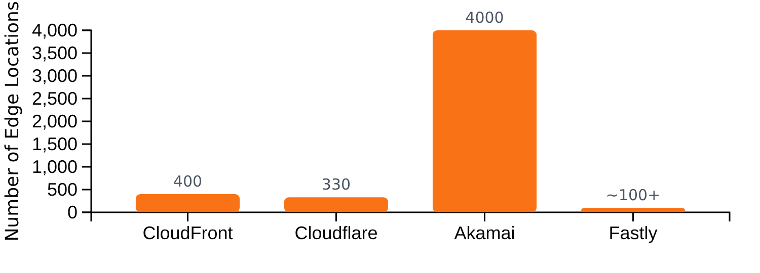


Pricing and Cost Optimization
AWS
Pricing Model
Cost Optimization Strategies
CloudFront uses a pay-as-you-go model with the following components:
TTL Optimization
Data Transfer: ~$0.085/GB in the US
Set appropriate TTL values to maximize cache hits and reduce origin requests.
Requests: Minimal additional cost
Regional Cost Variations
Content Compression
Enable compression to reduce content size and transfer costs.
Security Integration
Leverage AWS WAF and Shield to reduce the risk of expensive DDoS attacks.

Slide 12





Implementation Best Practices
AWS
Distribution Configuration
Security Settings
Use consistent naming conventions for distributions
Enable HTTPS/SSL for secure communication
Configure TTL values based on content update frequency
Use Origin Access Identity (OAI) for S3 origins
Use cache behaviors for granular control
Implement AWS WAF for application-layer protection
Origin Selection
Performance Optimization
Choose origins close to your users for better latency
Use compression for smaller content sizes
Use S3 Transfer Acceleration for large file transfers
Implement pre-signing for dynamic content
Implement origin failover for high availability
Use edge computing for content customization

Slide 13













Summary and Key Takeaways
AWS
Core Benefits
Ideal Use Cases
Global Speed & Performance
Web Content
Video Streaming
Delivers content with minimal latency through a network of 400+ edge locations across 48 countries.
Accelerates static and dynamic web content delivery
Optimizes video delivery with live and on-demand capabilities
Enhanced Security
Integrated DDoS protection, Web Application Firewall, and HTTPS support to protect content and applications.
APIs
Mobile Apps
Enhances API performance and security
Improves mobile application performance
Programmable Edge Computing
Customizes content delivery with Lambda@Edge and CloudFront Functions for enhanced user experiences.
Unique AWS Advantages
Seamless integration with AWS services (S3, EC2, Lambda, Shield, WAF)
Pay-as-you-go pricing with transparent cost control
Deep ecosystem integration for comprehensive cloud solutions

